Slide 1
Challenges
Final challenge

Slide 2
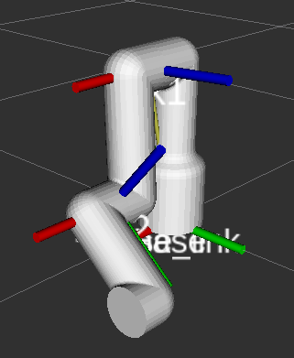
Final Challenge
This challenge is intended for the student to review the concepts introduced in this class.
This challenge aims to show the behaviour of the computer torque control in robotics.
This challenge will be divided in different sections.

Slide 3
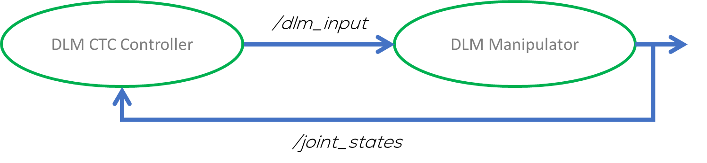
Introduction
The challenge consists of developing a node containing the CTC controller for the Dual Link Manipulator.
The student can choose to use the previously developed DLM (previous challenge) or use the one provided by MCR2. This does not affect the grade.
If using the package developed previously, you must describe the code of your DLM simulation in the video report and the DLM parameters you used in your code.
If using your own package, the student must subscribe to the “/joint_states” topic of its DLM simulation and provide the system's input in the topic “/dlm_input.”
If using multiple topics as inputs, explain in your report, the name of the topic, why? And the type of message used.

Slide 4
MCR2 DLM Package
MCR2 Provides a pre-made package that models and controls a DLM.
The package contain two main pre-made scripts:
dlm_dyn_sim.py: Pre-made script to simulate the DLM dynamics (do not change!!).
ctc_ctrl.py: Pre-configured file that shows a basic example of how to send and receive data to the DLM system (To be modified by the student).
The package also contains all the necessary files to model the pendulum (URDF, STL models, RVIZ configuration).
Two launch files are contained in the package:
dlm_sim.launch: Starts the simulation of the DLM system, without RVIZ or any other program.
dlm.launch: Initialises the DLM simulation, RVIZ, the joint state publisher and the ctc_ctrl.py
The student should use this pre-made package to define the CTC control inside the “ctc_ctrl.py” script.

Slide 5
MCR2 DLM Package
Download the package “dlm_sim”, from GitHub “Week5/Challenge/dlm_sim” to your “catkin_ws”
Give executable permission to the files
cd ~/catkin_ws/src/dlm_sim/scripts/
sudo chmod +x ctc_ctrl.py
sudo chmod +x dlm_dyn_sim.py
Compile it using “catkin_make” and source the workspace “source devel/setup.bash ”
Run the package using the roslaunch command
roslaunch dlm_sim dlm.launch
The dual pendulum should appear in RVIZ

Slide 6
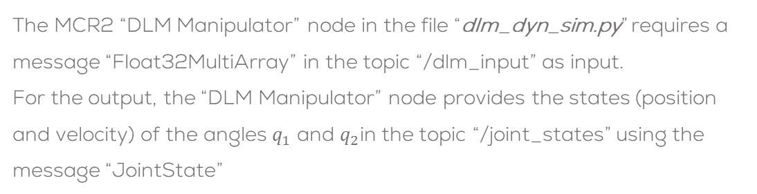
MCR2 DLM Package
The MCR2 “DLM Manipulator” node in the file “dlm_dyn_sim.py” requires a message “Float32MultiArray” in the topic “/dlm_input” as input.
For the output, the “DLM Manipulator” node provides the states (position and velocity) of the angles $q_{1}$ and $q_{2}$in the topic “/joint_states” using the message “JointState”
System Input message (/dlm_input)
std_msgs/Float32MultiArray
Float32MultiArray # Input to the system
More information here
DLM CTC Controller
/dlm_input
DLM Manipulator
/joint_states
The CTC Node in “ctc_ctrl.py” sends the data required by the manipulator simulation in the specific topics. It also shows an example on how to send and receive the data to/from the node “DLM Manipulator”
System output message (/ joint_states)
sensor_msgs/ JointState
JointState # Output to the system
More information here

Slide 7
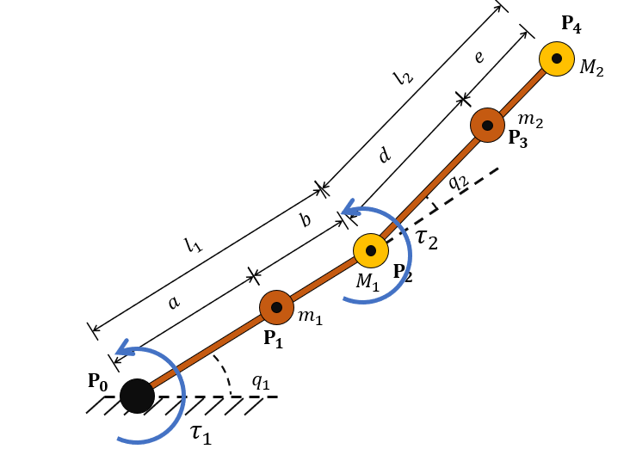

MCR2 DLM Package
The parameters and its values of the DLM System are based as the ones shown in the figure:
link1_mass ($m_{1}$) = 1.5 kg
link2_mass ($m_{2}$) = 1.5 kg
link1_end_mass ($M_{1}$) = 1.0 kg
link2_end_mass ($M_{2}$) = 2.0 kg
link1_length ($l_{1}$)= 0.4 m
link1_COM_pos ($a$) = 0.2 m
link2_length ($l_{2}$) = 0.4 m
link2_COM_pos ($d$) = 0.2 m
gravity ($g$) = 9.8
Masses of the dual link manipulator
Links lengths
and COM positions
Environment variables

Slide 8
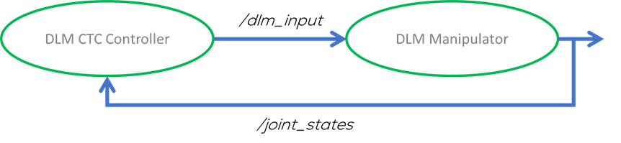
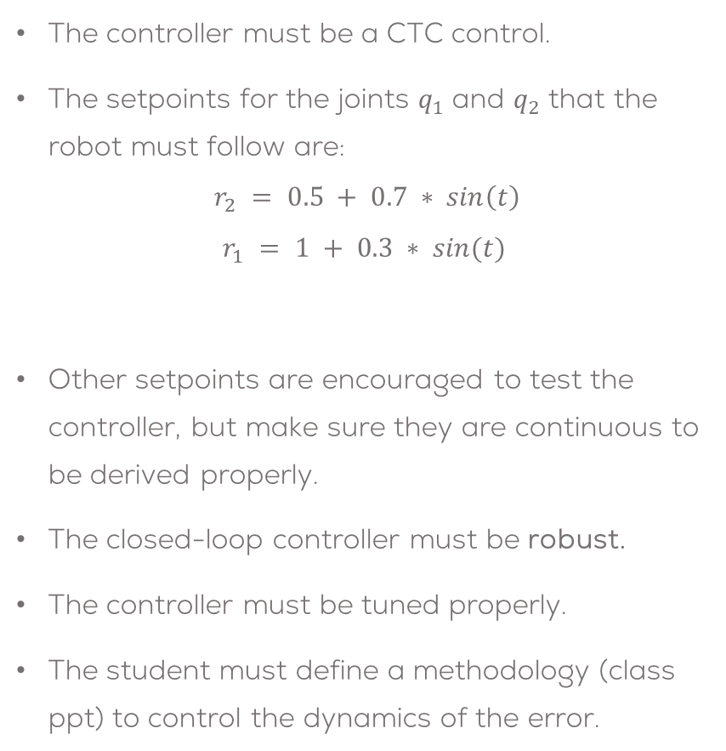
Controller
The controller must be a CTC control.
The setpoints for the joints $q_{1}$ and $q_{2}$ that the robot must follow are:
$$r_{2} = 0.5 + 0.7 ∗ sin\left(t\right)$$
$$r_{1} = 1 + 0.3 ∗ sin(t)$$
Other setpoints are encouraged to test the controller, but make sure they are continuous to be derived properly.
The closed-loop controller must be robust.
The controller must be tuned properly.
The student must define a methodology (class ppt) to control the dynamics of the error.
Students are encouraged, but not required, to use a config file or a parameter in the launch file to establish the controller parameters.
The student must define what is robustness and implement strategies to achieve it with the controller.

Slide 9
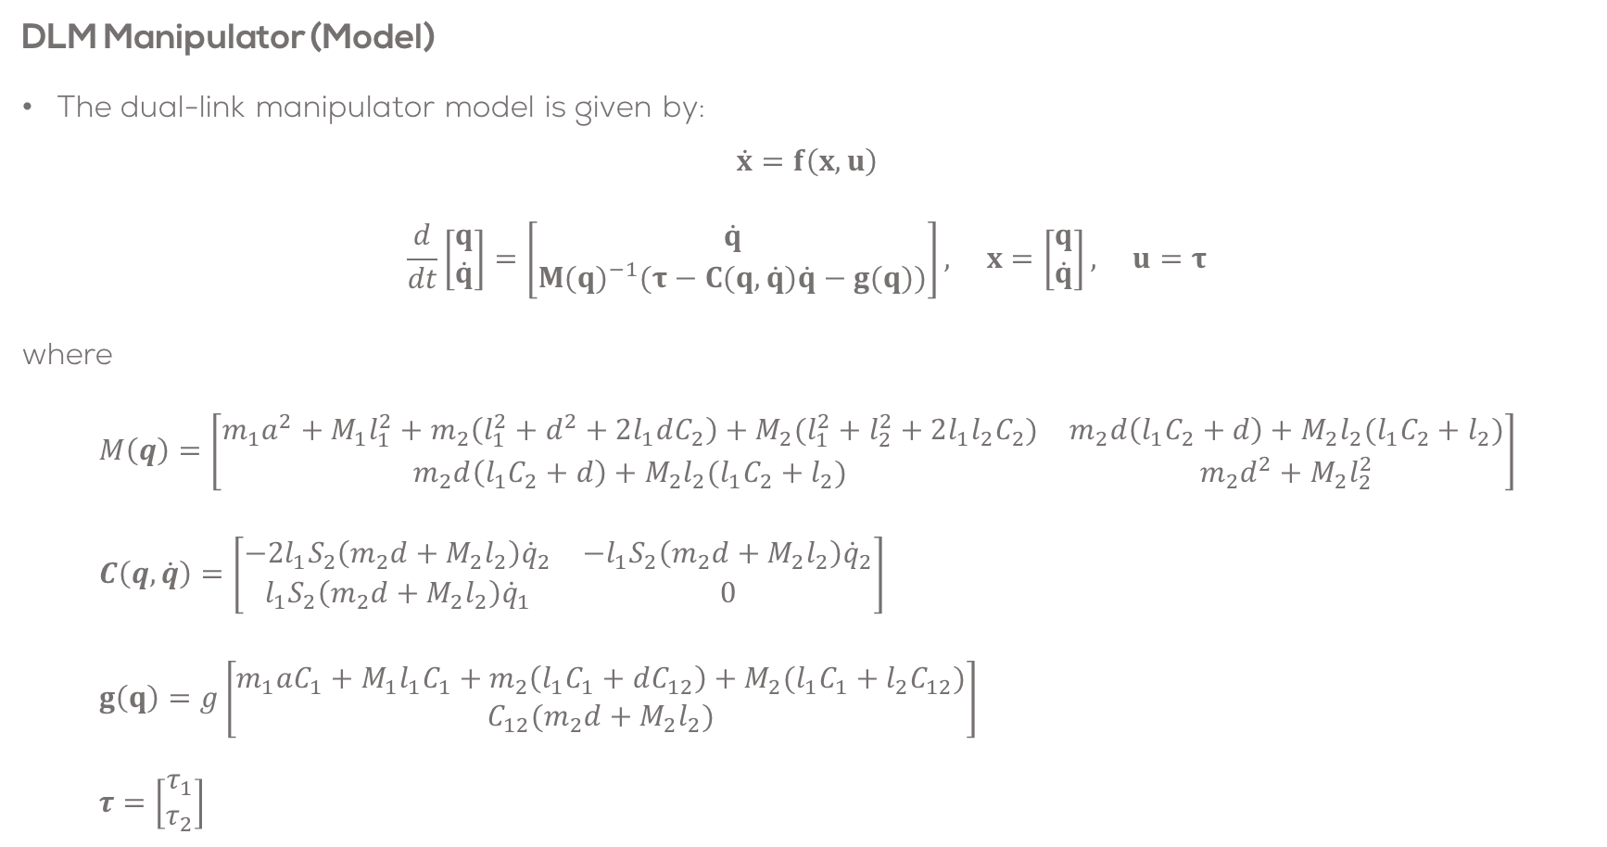
Controller Dual Link Manipulator Model
DLM Manipulator (Model)
The dual-link manipulator model is given by:
$$\dot{x}=f\left(x,u\right)$$
$$\frac{d}{dt}\left[\begin{matrix}q \\ \dot{q}\end{matrix}\right]=\left[\begin{matrix}\dot{q} \\ M(q)^{−1}(τ−C(q,\dot{q})\dot{q}−g(q))\end{matrix}\right], x=\left[\begin{matrix}q \\ \dot{q}\end{matrix}\right], u=τ$$
where
$$M\left(q\right)=\left[\begin{matrix}m_{1}a^{2}+M_{1}l_{1}^{2}+m_{2}\left(l_{1}^{2}+d^{2}+2l_{1}dC_{2}\right)+M_{2}(l_{1}^{2}+l_{2}^{2}+2l_{1}l_{2}C_{2}) & m_{2}d\left(l_{1}C_{2}+d\right)+M_{2}l_{2}(l_{1}C_{2}+l_{2}) \\ m_{2}d\left(l_{1}C_{2}+d\right)+M_{2}l_{2}(l_{1}C_{2}+l_{2}) & m_{2}d^{2}+M_{2}l_{2}^{2}\end{matrix}\right] \\ C\left(q,\dot{q}\right)=\left[\begin{matrix}−2l_{1}S_{2}\left(m_{2}d+M_{2}l_{2}\right){\dot{q}}_{2} & −l_{1}S_{2}\left(m_{2}d+M_{2}l_{2}\right){\dot{q}}_{2} \\ l_{1}S_{2}\left(m_{2}d+M_{2}l_{2}\right){\dot{q}}_{1} & 0\end{matrix}\right] \\ g\left(q\right)=g\left[\begin{matrix}m_{1}aC_{1}+M_{1}l_{1}C_{1}+m_{2}\left(l_{1}C_{1}+dC_{12}\right)+M_{2}(l_{1}C_{1}+l_{2}C_{12}) \\ C_{12}(m_{2}d+M_{2}l_{2})\end{matrix}\right] \\ τ=\left[\begin{matrix}τ_{1} \\ τ_{2}\end{matrix}\right]$$

Slide 10
Deliverables
The student must submit a video showing their results.
Duration: Under 4 min. (If longer, increase speed)
Show face, name and student ID number.
Video in English (preferred) or Spanish
Upload to CANVAS
This is an engineering report (it will be graded accordingly):
Use the third-person
Do not use expressions like “the controller works well”, “it's fine”, “robust”, “optimal”, etc. unless you can prove it (be serious with your results).
Use different metrics (maybe error-based) to analyse your system.
Show plots of the set points, control inputs, errors, and system output and use them to analyse the behaviour.
Do not conclude things like “I learned a lot”, “it was very challenging”, “everything looks fine”, etc. Conclusions based on the results, problems faced, solutions, etc.
Tasks
Brief introduction (problem to be solved, solution strategy, team tasks, etc.)
Explain how the program works (launch files, libraries made, the structure of the project, etc.). Use the code but also use flowcharts to explain the code If using your own DLM, explain in this section the code, parameters, inputs and outputs of your model.
Show the results of the robot being controlled. Try different scenarios (other setpoints to control the robot)
Explain the methodology followed to tune the controller parameters
Analysis of the robot’s behaviour. What is expected? Is the behaviour good? Why? Establish a metric to verify if the behaviour of the robot is good or not. Advantages/disadvantages of this type of Ccontrol? Problems with this type of control?
A brief set of conclusions from the task. The conclusions should be about the practice and the theoretical aspects of the robot, not about your personal experiences.

Slide 11
Rules
This is challenge not a class. The students are encouraged to research, improve tune explain their algorithms by themselves.
MCR2(Manchester Robotics) Reserves the right to answer a question if it is determined that the questions contains partially or totally an answer.
The students are welcomed to ask only about the theoretical aspect of the classed.
No remote control or any other form of human interaction with the simulator or ROS is allowed (except at the start when launching the files).
It is forbidden to use any other internet libraires with the exception of standard libraires or NumPy.
If in doubt about libraires please ask any teaching assistant.
Improvements to the algorithms are encouraged and may be used as long as the students provide the reasons and a detailed explanation on the improvements.
All the students must be respectful towards each other and abide by the previously defined rules.
Manchester robotics reserves the right to provide any form of grading. Grading and grading methodology are done by the professor in charge of the unit.

